Slide 1
Linked List

Slide 2
Singly linked list operations
Traversing
Insertion
Deletion

Slide 3
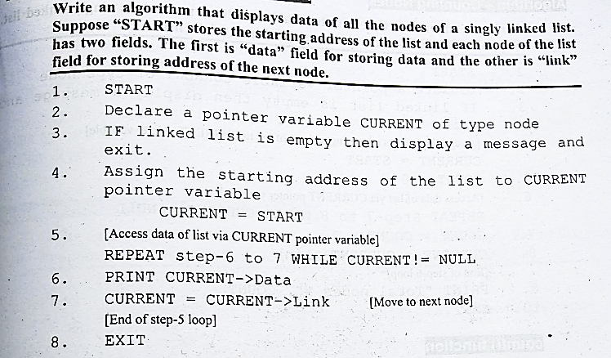
Traversing Singly linked list

Slide 4
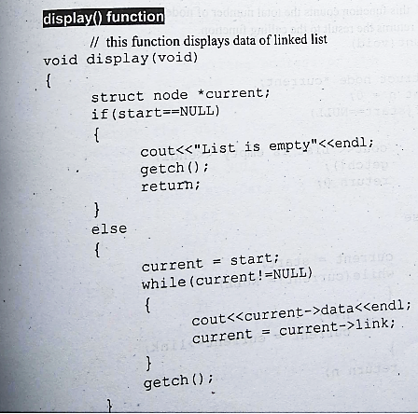
Code

Slide 5
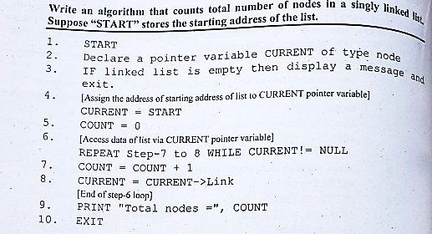
Counting nodes of singly linked listn

Slide 6
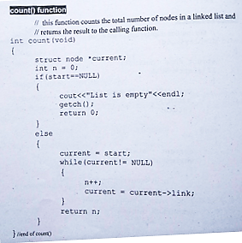
Counting nodes of singly linked list

Slide 7
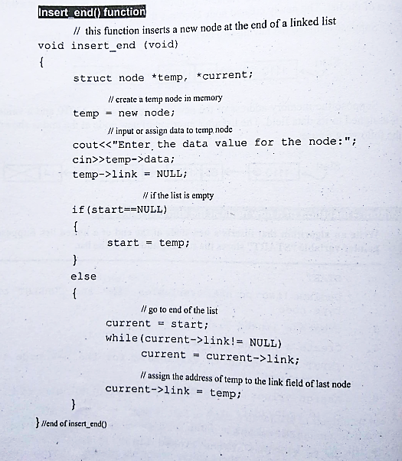
Insertion of a node at the end

Slide 8
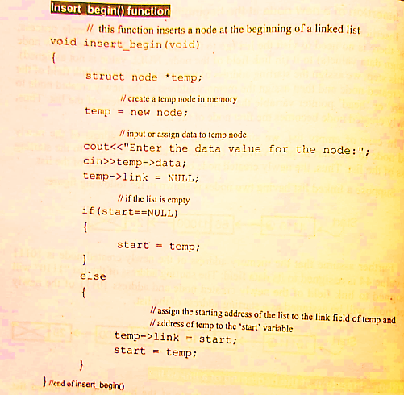
Insertion of a node at the Beginning

